Slide 1

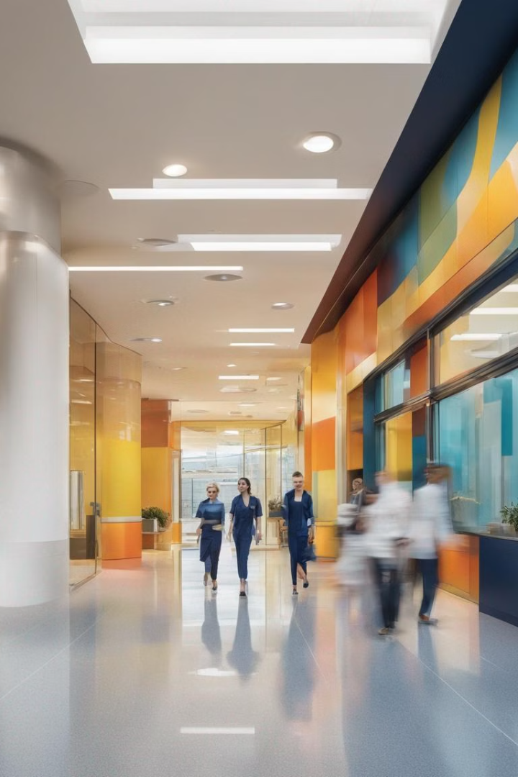
The Modern Hospital Environment
Hospitals today are complex, fast-paced environments that require advanced systems to manage patient care, operational efficiency, and security. This presentation will explore how AI and IoT technologies can revolutionize the hospital experience for both patients and staff.

Slide 2
Current Challenges in Patient Care and Hospital Operations
Patient Care Challenges
Operational Challenges
Technological Gaps
Ensuring accurate monitoring, prompt response to emergencies, and personalized care can be difficult with manual processes.
Coordinating resources, streamlining workflows, and maintaining security can strain hospital staff and budgets.
Existing systems often work in silos, lacking the integration and intelligence to address these complex challenges.

Slide 3

Limitations of Existing Solutions
1
Fragmented Data
2
Reactive Approach
3
High Maintenance
Disparate systems with poor interoperability lead to siloed information and inefficient decision-making.
Many solutions focus on responding to issues rather than proactively preventing them.
Complicated configuration and integration requirements make existing solutions costly and time-consuming to deploy.

Slide 4





Leveraging AI and IoT for a Comprehensive Solution
Connected Data
Intelligent Automation
Integrate and analyze real-time data from various sources to provide a unified view of hospital operations.
Implement AI-driven algorithms to automate processes, predict issues, and optimize resource allocation.
IoT Connectivity
Cloud-based Platform
Deploy IoT sensors and devices to enable remote monitoring, early detection, and proactive response.
Leverage the scalability and flexibility of cloud technology to deliver a seamless, integrated solution.

Slide 5
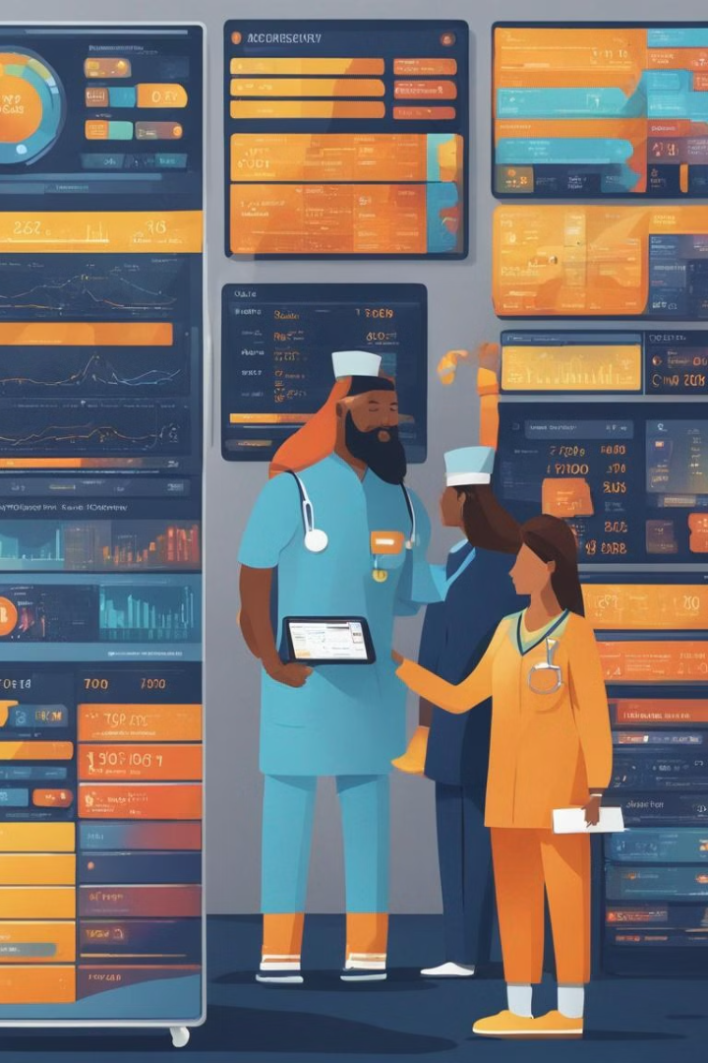
Key Features of the Proposed Platform
1
Patient Monitoring
Continuous, non-invasive monitoring of vital signs, activity levels, and environmental factors to detect early warning signs.
2
Real-time Alerts
Intelligent algorithms that analyze data streams and trigger timely alerts to enable prompt intervention.
3
Automated Workflows
Streamlined processes for resource allocation, task scheduling, and supply chain management.

Slide 6

Enhancing Patient Experience and Safety
Personalized Care
Dignified Environment
Tailored treatment plans and proactive interventions based on individual patient data and preferences.
Ambient lighting, soothing sounds, and customizable settings to create a more comfortable, calming atmosphere.
Seamless Coordination
Enhanced Safety
Streamlined communication and collaboration between care teams, ensuring a cohesive patient experience.
Advanced security features and emergency response protocols to protect patients, visitors, and staff.

Slide 7




Streamlining Hospital Operations and Administration
Resource Optimization
AI-driven allocation of staff, equipment, and supplies based on real-time demand and predicted needs.
Workflow Automation
Automated scheduling, task management, and inventory tracking to improve efficiency and reduce manual errors.
Data-driven Insights
Comprehensive analytics and reporting to support informed decision-making and continuous improvement.

Slide 8

Conclusion
Improved Patient Care
Enhanced Safety and Security
Optimized Operations
Personalized monitoring, timely intervention, and a more comfortable environment.
Advanced threat detection, emergency response, and secure access control.
Efficient resource allocation, automated workflows, and data-driven decision-making.

Slide 9

Thank You

